Slide 1

Strings
Alp KUT
Derya BİRANT
Kökten Ulaş BİRANT

Slide 2
Outline
Characters
Strings
String Operations
Examples

Slide 3
Characters
Character data type is used to store one alphanumeric data, such as letters, numbers, spaces, symbols, and punctuation.
Examples: A B a b 1 2 ; ? # % ...

Slide 4
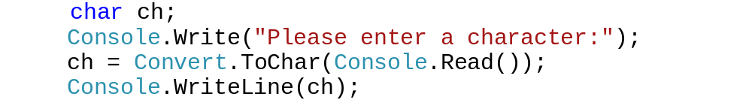
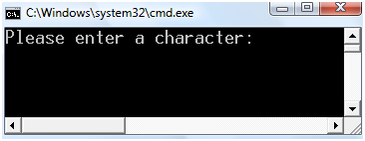
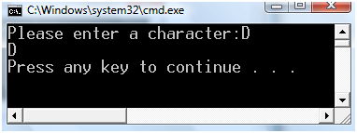
Characters in C#
The statement char ch; declares a single-byte variable named "ch" which holds one character.
Example:

Slide 5
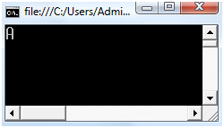
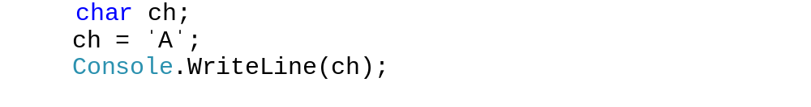
Characters in C#
The value of a char is assigned in single quote (ˈˈ) using the standard assignment operator (=) .
Example:

Slide 6
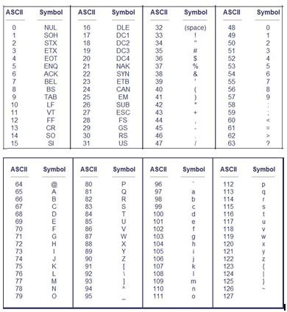

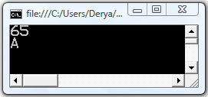
ASCII Character Codes

Slide 7
Strings
A string is an ordered sequence of characters.
Examples: "Apple" "Sea"
A string data type is a data type storing a sequence of data values, usually bytes, in which elements usually stand for characters.

Slide 8
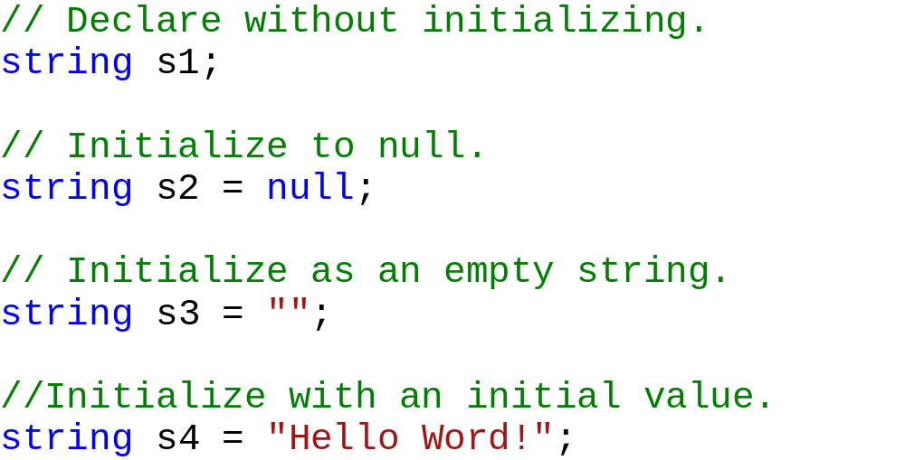
Strings in C#
A string variable can be declared in different ways:

Slide 9
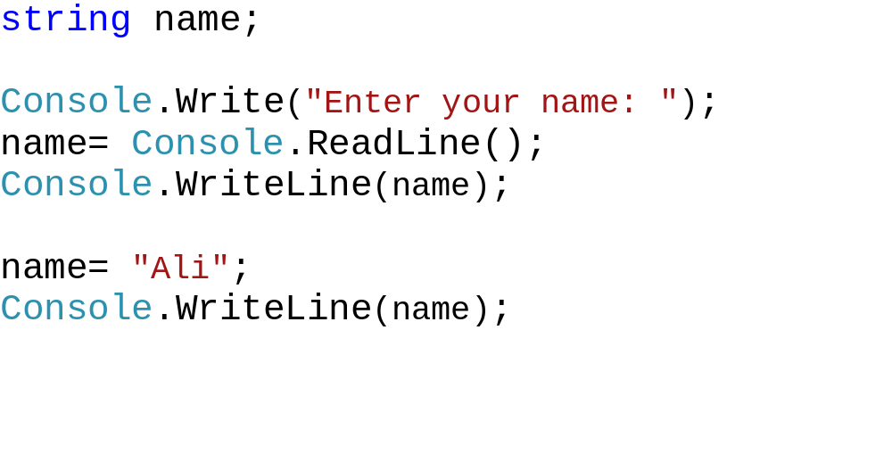
Strings in C#
The value of a string is assigned in double quotes (" ") using the standard assignment operator (=).
Example:

Slide 10
String Operations
Most popular operations over strings:
Concatenate
Equals
CompareTo
Length
Indexer
Substring
ToLower and ToUpper
Split
Indexof
Contains
...

Slide 11
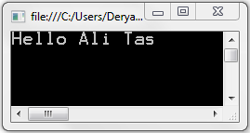
String Concatenate
String concatenation can be done using + operator
Example:
string name = "Ali";
string surname = "Tas";
string str;
str = "Hello " + name + " " + surname;
Console.WriteLine(str);

Slide 12
Comparing Strings
There are several ways to compare strings for equality
Equals()
  Returns true if they are equal, otherwise false
== and != operators
  Returns true or false
CompareTo()
  Returns 0 if equal, negative if less, positive if greater

Slide 13
Comparing Strings
string str1 = "hello";
string str2 = "mello";
if (str1.Equals(str2))
Console.WriteLine("Equal");
else
Console.WriteLine("Not equal");
if (str1 == str2)
Console.WriteLine("Equal");
else
Console.WriteLine("Not equal");
int result = str1.CompareTo(str2);
if (result == 0)
Console.WriteLine("Equal");
else if (result > 0)
Console.WriteLine("Greater");
else
Console.WriteLine("Less");

Slide 14
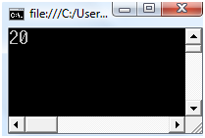
String Length
Returns the length of the string
Useful for loops
Example:
string str;
str = "Bugun hava cok guzel";
Console.WriteLine(str.Length);

Slide 15
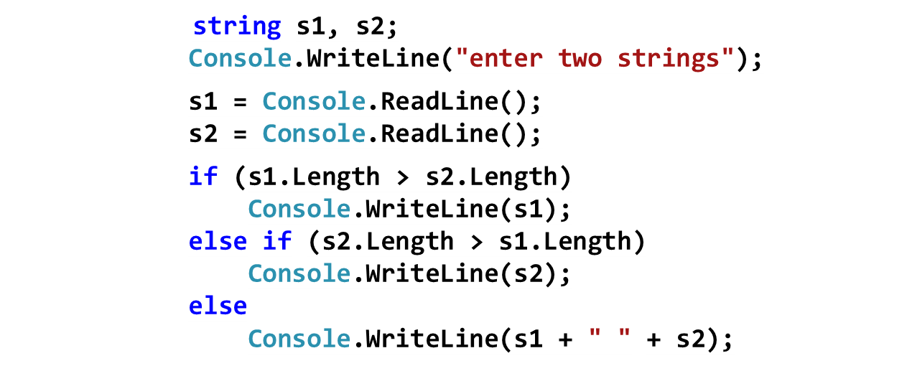
Question
Take two strings from the user and print the longest one.
Example:
Inputs: derya
cem
Output: derya

Slide 16
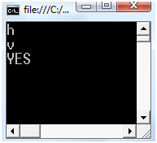
String Indexer
Retrieves any character in the string using a subscript
Example:
string str;
str = "Bugun hava cok guzel";
Console.WriteLine(str[6]);
Console.WriteLine(str[8]);
if (str[4]=='n')
Console.WriteLine("YES");

Slide 17
Example
Write a program that finds “how many times letter ‘a’ appears in the string”
string str = "Bugun hava çok güzel";
int counter = 0;
for (int i = 0; i < str.Length; i++)
if (str[i] == 'a')
counter++;
Console.WriteLine(counter);

Slide 18
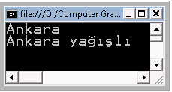
Substring
Retrieves a substring from this instance.
  The substring starts at a specified character position.
Substring(startIndex)
  The substring starts at a specified character position and has a specified length
Substring(startIndex, length)
Example:
string str = "İstanbul soğuk, Ankara yağışlı";
string str2;
str2 = str.Substring(16, 6);
Console.WriteLine(str2);
str2 = str.Substring(16);
Console.WriteLine(str2);

Slide 19
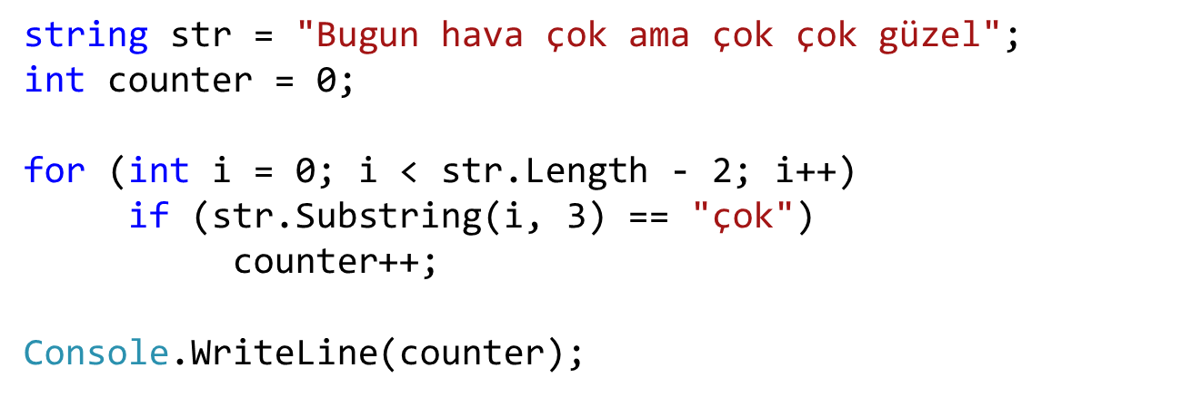
Example
Write a program that finds “how many times word ‘çok’ appears in the string”

Slide 20
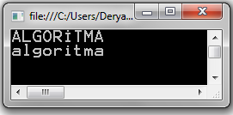
ToLower – ToUpper
ToLower : Returns a copy of the string converted to lowercase
ToUpper : Returns a copy of the string converted to uppercase
Example:
string str = "AlGoRitmA";
string output;
output = str.ToUpper();
Console.WriteLine(output);
output = str.ToLower();
Console.WriteLine(output);

Slide 21
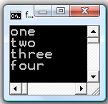
Split
Returns a string array that contains the substrings in this instance that are delimited by elements of a specified string.
Split( separator)
Example:
string str = "one;two;three;four";
string[] words = null;
words = str.Split(';');
for (int i = 0; i < words.Length; i++)
Console.WriteLine(words[i]);

Slide 22
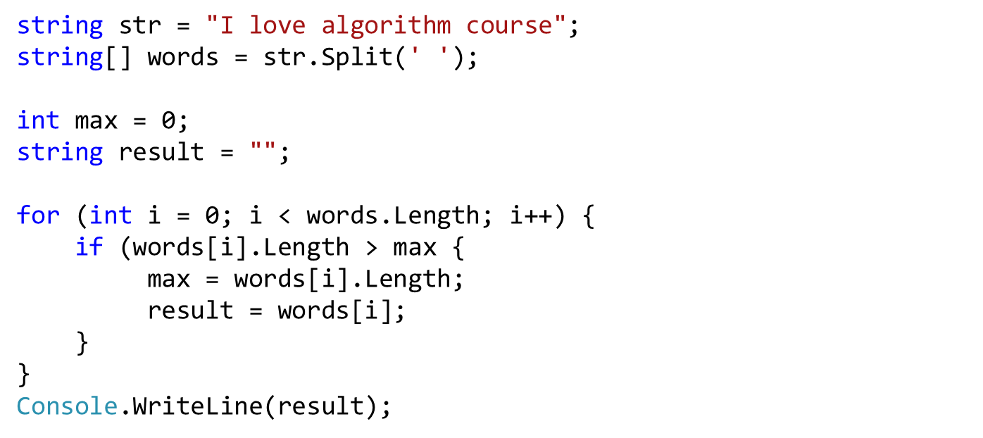
Example
Print the longest word in the string

Slide 23
Char/String Search
Finds the position of a char or string
IndexOf (value, startIndex)
  value: The string to seek
  startIndex: The search starting position (optional)
int index;
string letters = "abcdefabcdef";
index = letters.IndexOf('*');
Console.WriteLine(index); // -1
index = letters.IndexOf('c');
Console.WriteLine(index); // 2
index = letters.IndexOf("def");
Console.WriteLine(index); // 3
index = letters.IndexOf('a', 3);
Console.WriteLine(index); // 6

Slide 24
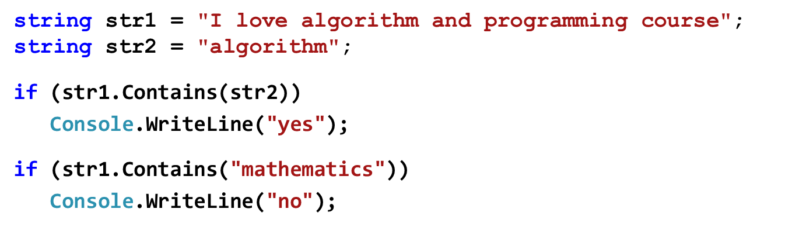
Contains
Returns a boolean value indicating whether the specified string occurs within another string
Contains( stringvalue )
Example:

Slide 25
Example
Write a program that finds a string is palindrome or not
ey edip adanada pide ye
anastas rulo iyi olur satsana
kalas yok kütük koy salak
string str = "MADAM";
bool flag = true;
for (int i = 0; i < (str.Length -1)/2; i++)
if (str[i] != str[str.Length-i-1])
flag = false;
if (flag)
Console.WriteLine("Palindrome");
else
Console.WriteLine("Not palindrome");

Slide 26
Example
Write a program that finds the similarity percentage of two strings
Example: "AHMET SABRİ KESGİN“
"AHNET SAPRİ KESKİN“
18 characters, 3 characters are different
100 – ((3 / 18) * 100) % 83.3
string str1="AHMET SABRİ KESGİN";
string str2="AHNET SAPRİ KESKİN";
double counter = 0;
for (int i = 0; i < str1.Length; i++)
if (str1[i] == str2[i])
counter++;
Console.WriteLine((counter / str1.Length) * 100);

